Slide 1
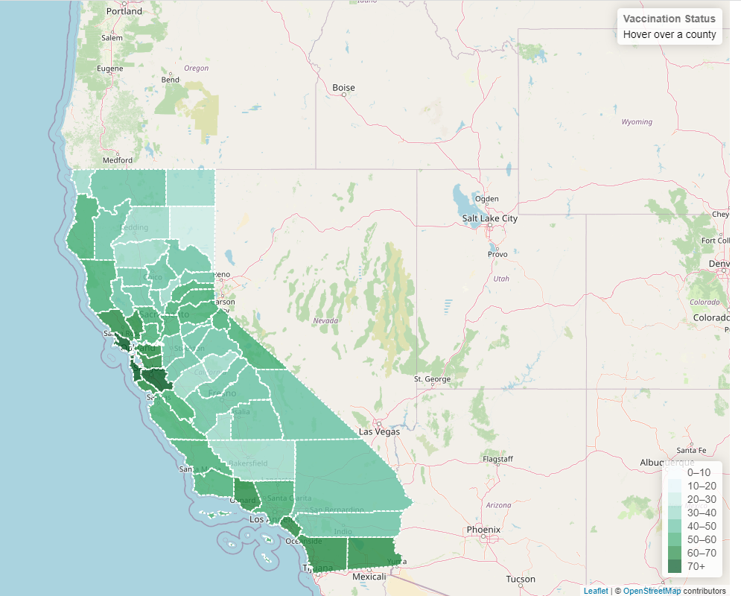

Covid-19 Vaccination Status
California Counties
Project – 3
Data Visualization
Prepared by:
TIKRAM SUBEDY

Slide 2
Purpose of the Project:
Create an interactive visualization dashboard for database on Covid-19 vaccination in California counties created during ETL project using
plots,
data, and
map

Slide 3
Data Sources, Collection and Processing:
Data Sources:
California department of public health
https://data.chhs.ca.gov/dataset/vaccine-progress-dashboard
World Population Review
https://worldpopulationreview.com/us-counties/states/ca
Github:
https://github.com/codeforgermany/click_that_hood/blob/main/public/data/california-counties.geojson

Slide 4
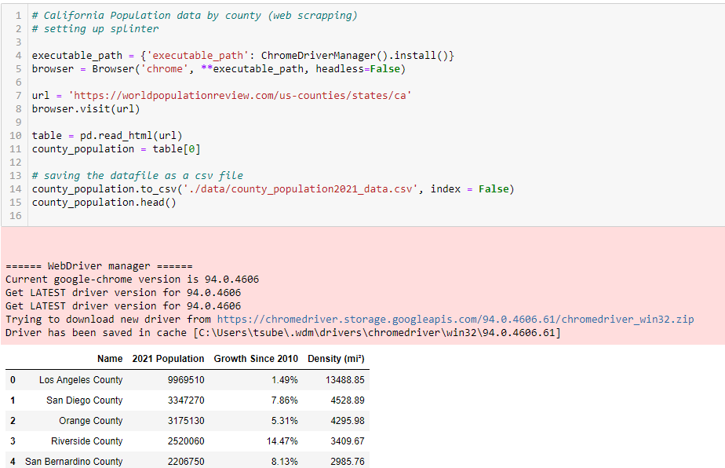
Data Sources, Collection and Processing:
Data Extraction:
Web scraping
Splinter
Downloading datafiles

Slide 5
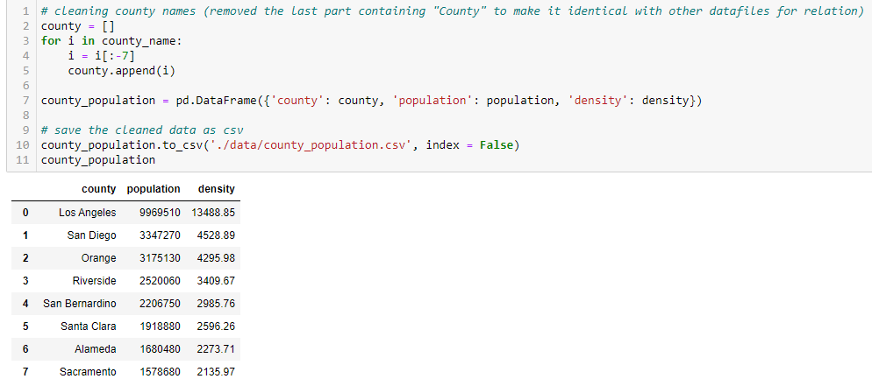
Data Sources, Collection and Processing:
Data Processing:
Python Pandas
(fixed inconsistent county names among the datafiles)

Slide 6
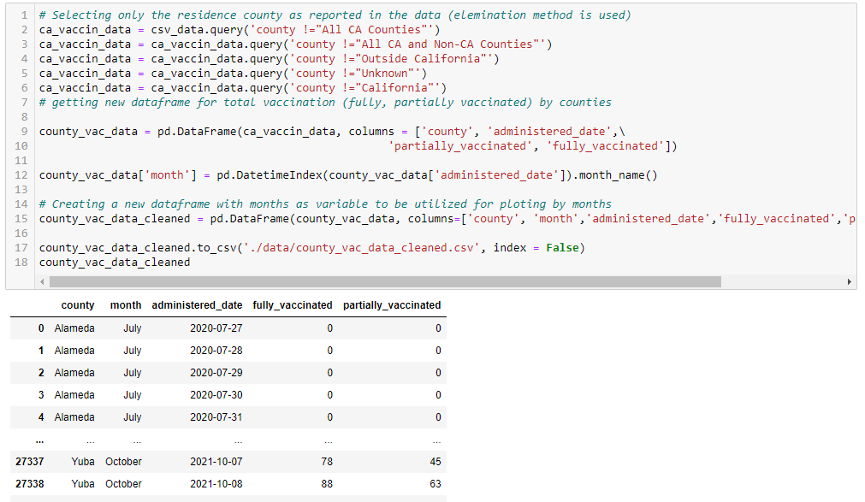
Data Sources, Collection and Processing:
Data Processing:
Python Pandas
(unnecessary data rows and ‘NA’s removed)

Slide 7
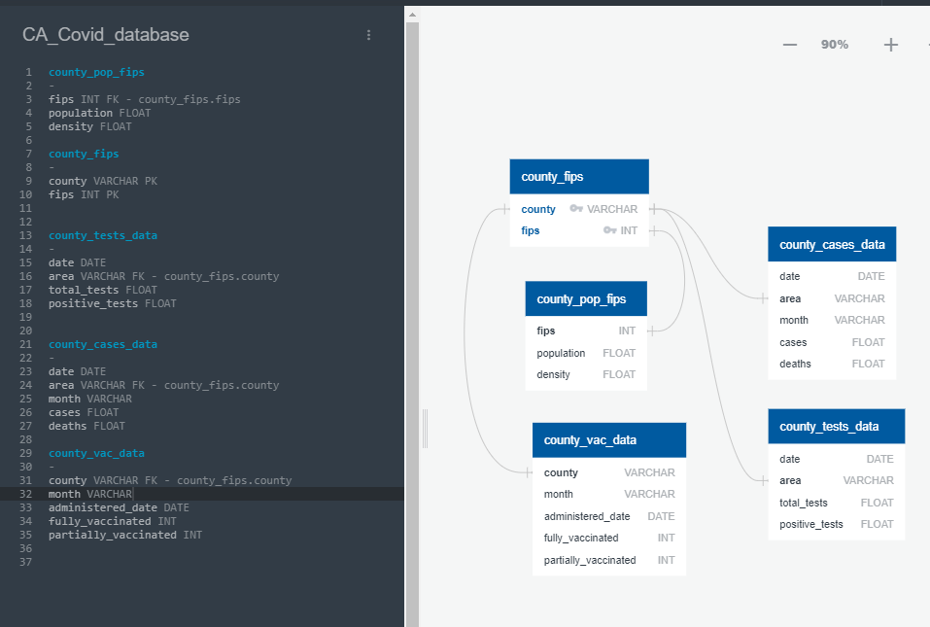
Database and Data Query:
ER Diagram:
(Established relation with primary and foreign keys)

Slide 8
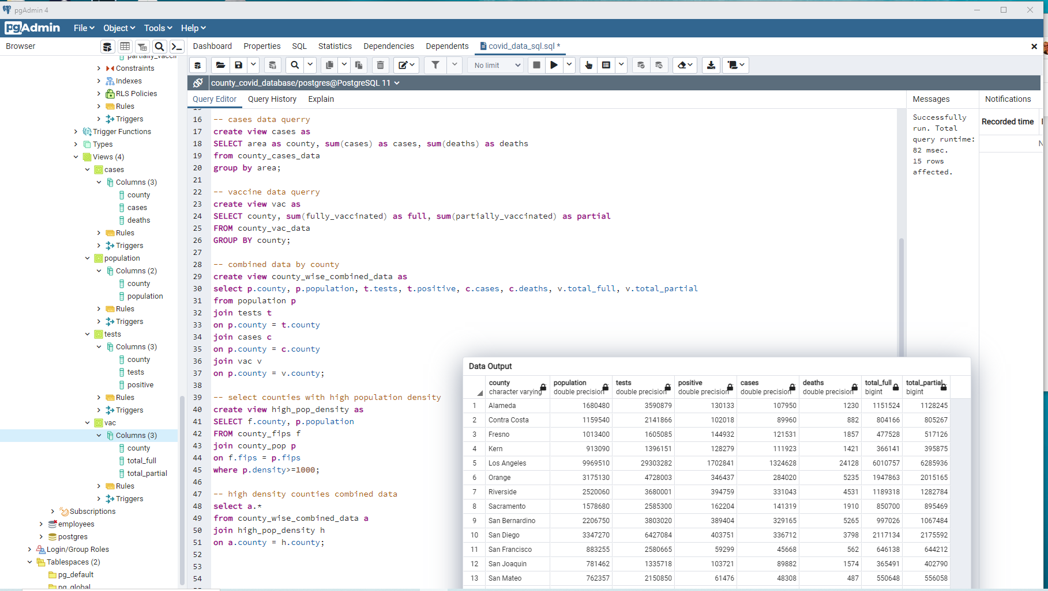
Database and Data Query:
SQL Queries:
Postgres,
PgAdmin

Slide 9
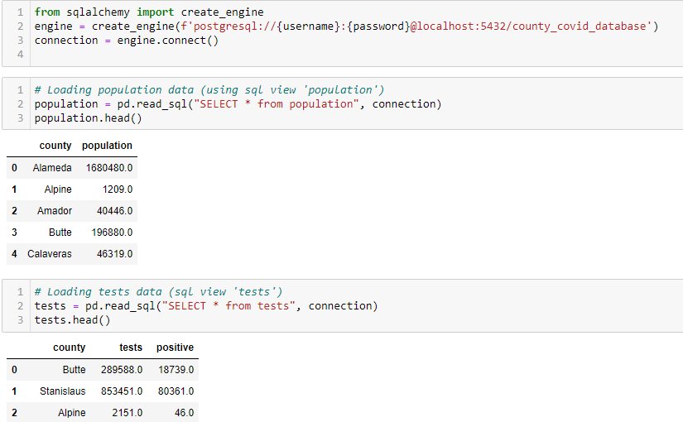

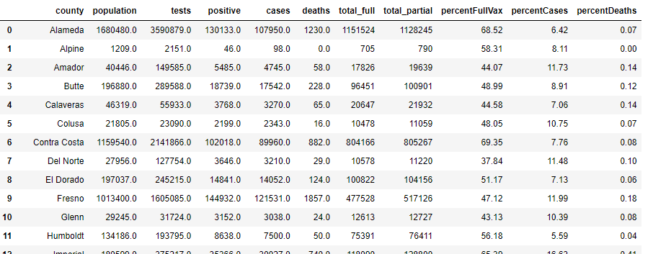
Database and Data Query:
Loading Database:
SQLAlchemy
(selecting SQL views to obtain the final database)

Slide 10

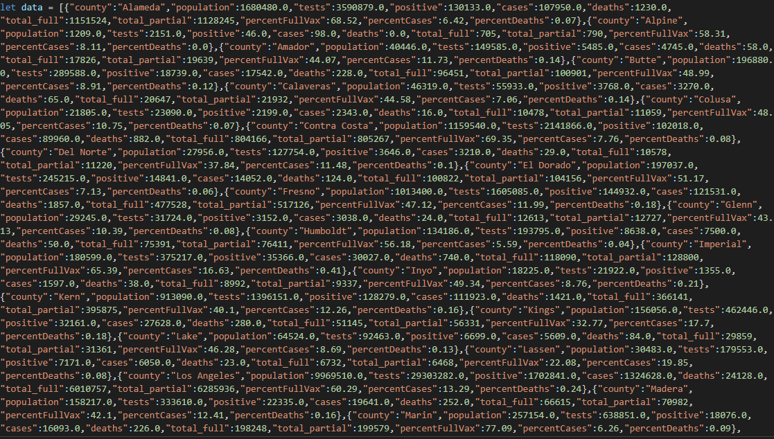
Loading Database:
Converting into Json data file

Slide 11
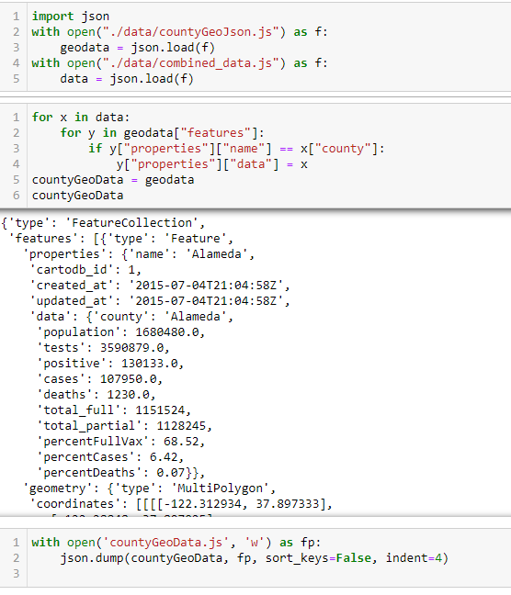
Loading Database:
Converting into Json data file

Slide 12
Data Visualization:
Javascript,
Plotly,
Leaflets
HTML, CSS

Slide 13
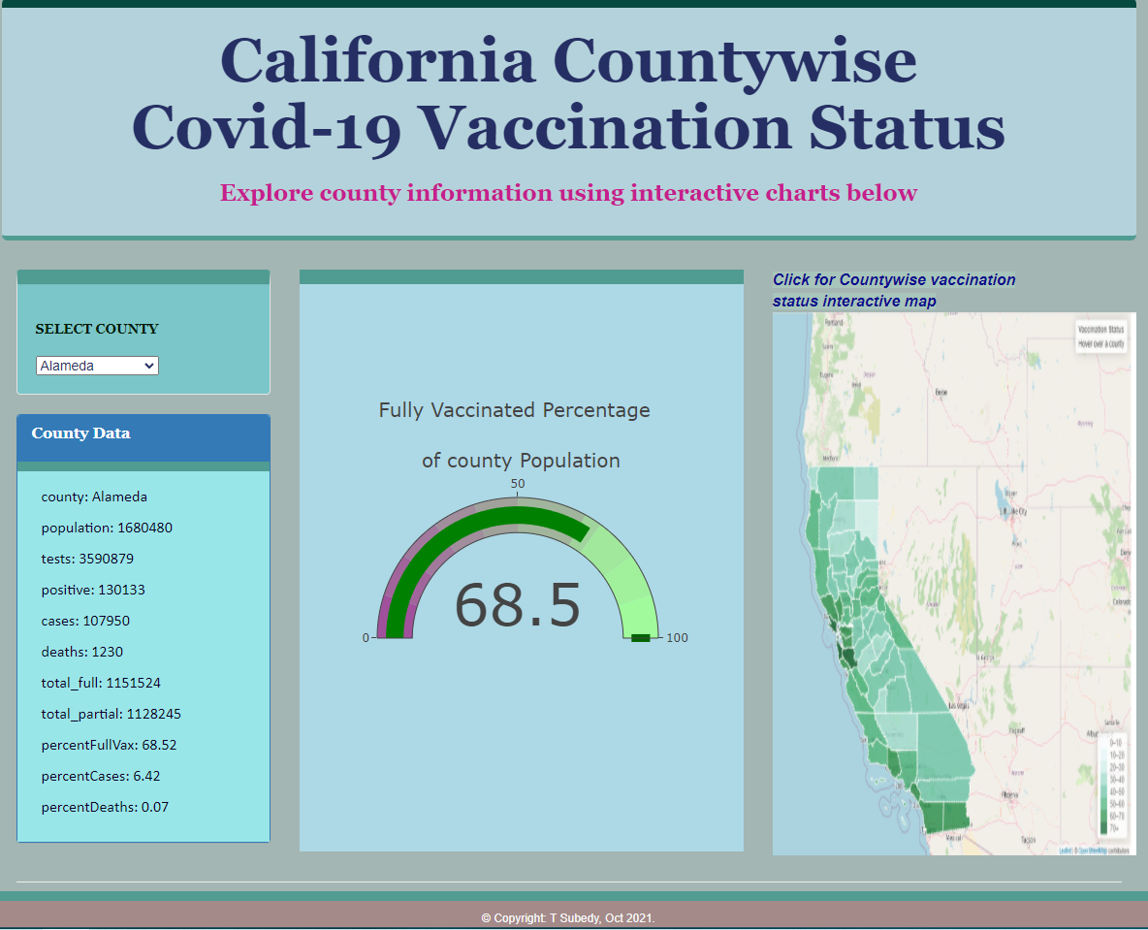
Dashboard and Data Visualization:
Dashboard:
Javascript
Plotly
Html/ CSS
Mapping
Leaflets
https://tsubedy.github.io/Project_3/

Slide 14
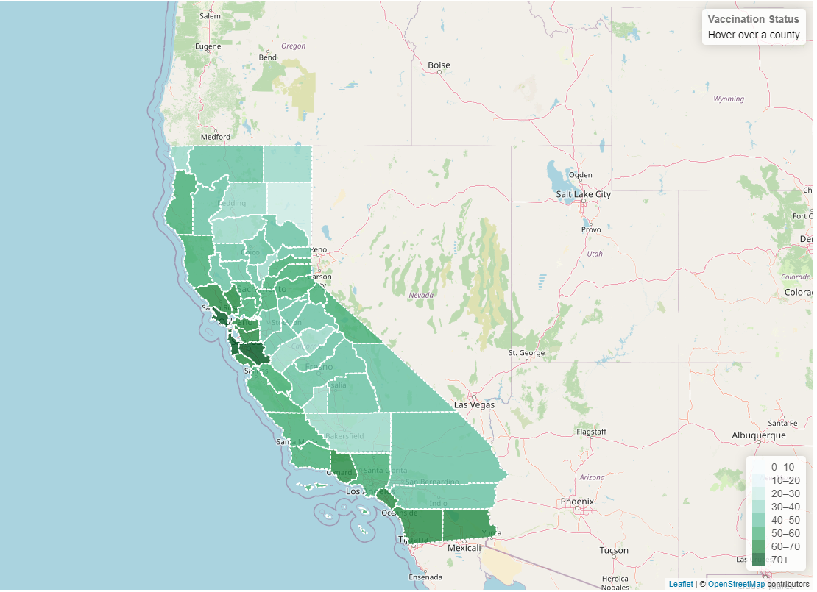
Dashboard and Data Visualization:
Dashboard:
Map using Leaflets
- Displays data on hoovering over the map and clicking on counties
- Legend colors are based data values)
https://tsubedy.github.io/Project_3/

Slide 15
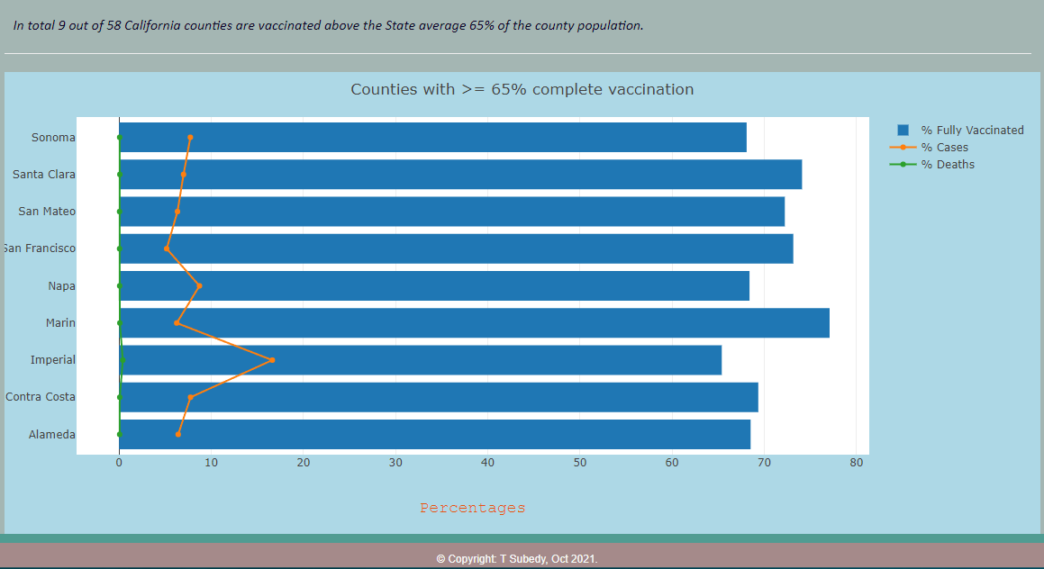
Dashboard and Data Visualization:
Dashboard:
Interactive bar chart
(with legends on/off)
https://tsubedy.github.io/Project_3/

Slide 16
Limitations:
The project is a part of the assignments from the class of Data Analytics Bootcamp and is limited to demonstrate the technical skills learned so far in the class.
Some of data used for this project are not up to date as they were downloaded in the form of csv files directly from the source sites.
Data is limited to 58 California Counties.
The visualizations show only the status of the California county vaccination.
It is not providing any statistical tests or analyses of the data.

Slide 17
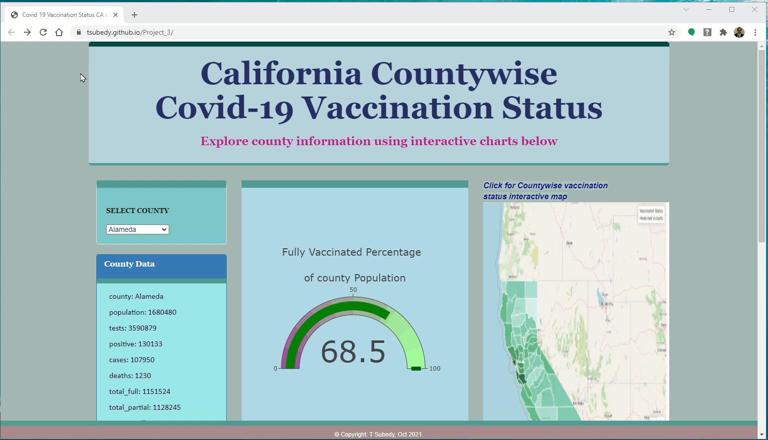
Web Page Demo:
https://tsubedy.github.io/Project_3/

Slide 18
Questions:
? ? ?
THANK YOU !!!

